Slide 1

Humanitarian Crisis Intelligence & Communication System (HCICS)
Geospatial Analysis of IDP Vulnerability in Sudan
Abdulrahman Sirelkhatim
MIT Emerging Talent Program - Cohort 6
Capstone Project | December 2025

Slide 2
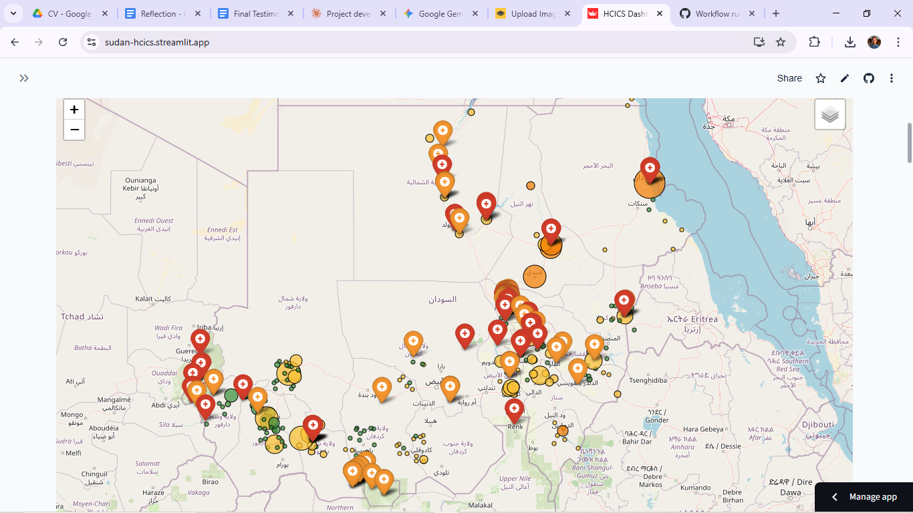
The Crisis Context
🌍 Ongoing Conflict: Sudan civil war since April 2023
👥 11.1M Internally Displaced - world's largest IDP population
🏥 38% of hospitals non-functional
📊 20.3M people require urgent health assistance
⚠️ Challenge: Where are the greatest humanitarian gaps?

Slide 3

The Information Problem
The Challenge:
  Fragmented data across multiple agencies (IOM, WHO, OCHA)
  Limited real-time situational awareness
  Reactive rather than anticipatory response
  No systematic prioritization framework
The Opportunity:
  Open humanitarian data exists
  Geospatial analysis can reveal patterns
  Machine learning can validate approaches

Slide 4
Research Question
"Can geospatial analysis of structured humanitarian data effectively identify and visualize critical gaps between IDP locations and health facility access?"
Hypothesis: Combining IDP displacement data with facility locations will reveal vulnerability patterns that can guide resource allocation.

Slide 5
Project Objectives
MVP Goals:
Map Vulnerability
  Calculate accessibility metrics
  Generate composite vulnerability scores
Validate Methodology
  Statistical rigor (Moran's I, ML)
  94%+ accuracy target
Visualize Insights
  Interactive dashboard
  Actionable recommendations
Establish Scalability
  Modular architecture
  API-ready framework

Slide 6
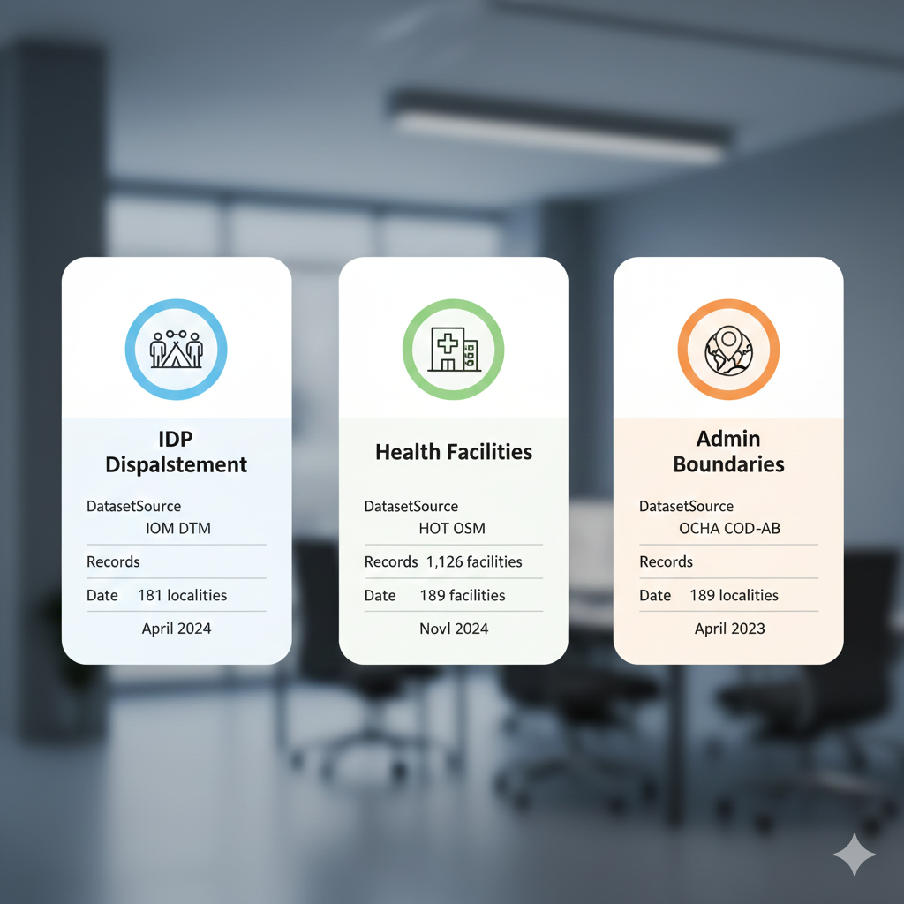
Data Sources

Slide 7
Data Sources
Dataset | Source | Records | Date
IDP Displacement | IOM DTM | 181 localities | April 2024
Health Facilities | HOT OSM | 1,126 facilities | Nov 2024
Admin Boundaries | OCHA COD-AB | 189 localities | April 2023
Quality
100% geographic coverage
Validated coordinates
Open humanitarian data licenses

Slide 8
Methodology Overview
Phase 1: Data Preparation ETL + Geocoding
↓
Phase 2: Proximity Analysis, Haversine distances, KD-tree queries
↓
Phase 3: Vulnerability Scoring Weighted composite index
↓
Phase 4: Statistical Validation Moran's I, Random Forest, Hypothesis testing
↓
Phase 5: Dashboard Communication

Slide 9
Phase 1 - Data Preparation
Challenges Solved:
  Missing coordinates → Verified 50+ major localities
  Arabic facility names → Translated 850+ entries
  Inconsistent formats → Standardized schema
Output:
  181 geocoded localities (6.55M IDPs)
  238 critical facilities (hospitals/clinics)
  Clean, analysis-ready datasets

Slide 10
Phase 2 - Proximity Analysis
Haversine Distance Formula:
d = 2R × arcsin(√(sin²(Δφ/2) + cos(φ₁)cos(φ₂)sin²(Δλ/2)))
Metrics Calculated:
  Distance to nearest hospital/clinic
  Facility count within 5km, 10km, 20km radii
  KD-tree optimization: O(log n) queries
Result:
  11 accessibility metrics per locality

Slide 11
Phase 3 - Vulnerability Index
Composite Score Formula:
Vulnerability =
0.4(IDP Burden) + 0.4(Facility Access) + 0.2(Origin Intensity)
Components:
  IDP Burden (40%): Population pressure
  Facility Access (40%): Distance + density
  Origin Intensity (20%): Conflict displacement
Risk Thresholds:
  Critical: ≥80 | High: 60-79 | Moderate: 40-59 | Low: <40

Slide 12
Phase 4 - Statistical Validation
Spatial Autocorrelation
  Moran's I = 0.4918 (p < 0.001)
  Significant geographic clustering confirmed
Machine Learning
  Random Forest: 94.6% accuracy
  Methodology validated
Hypothesis Testing
  Darfur vs Non-Darfur: p = 0.0012
  Regional differences significant

Slide 13
Key Finding #1 - The Accessibility Crisis
86% of localities exceed 20km threshold
Mean distance: 88.1km to nearest hospital
17.6× WHO recommended maximum (5km)
5.09M IDPs severely underserved
156 localities require mobile health clinics
Implication: Fixed infrastructure expansion insufficient

Slide 14
Key Finding #2 - The Darfur Paradox
Counterintuitive Result:
  Darfur vulnerability: 31.90
  Non-Darfur vulnerability: 42.33
  Statistical difference: p < 0.001
Why?
  Outward displacement (IDPs fled FROM Darfur)
  Receiving regions overwhelmed (River Nile, Red Sea)
  Data capture limitations in conflict zones

Slide 15
Key Finding #3 - River Nile Concentration
Top 5 Most Vulnerable Localities:
4 of 5 are in River Nile state (IDP hosting burden)
Rank | Locality | State | Score | Risk
1 | Shendi | River Nile | 73.7 | High
2 | Port Sudan | Red Sea | 68.7 | High
3 | Ad Damar | River Nile | 63.4 | High
4 | Atbara | River Nile | 63.3 | High
5 | Ed Damazine | Blue Nile | 61.7 | High

Slide 16
Machine Learning Insights
What Drives Vulnerability?
Validation:
  94.6% prediction accuracy
  Methodology statistically robust
  Crisis patterns are quantifiable
Feature | Importance
IDP Burden Score | 38.4%
Origin Intensity Score | 34.8%
Facility Access Score | 26.8%

Slide 17
Phase 5 - Dashboard Communication
Interactive Features:
  🗺️ Interactive vulnerability map (Folium)
  📊 Real-time KPI metrics
  📈 Statistical validation charts
  📥 Export functionality (CSV, GeoJSON)
Architecture:
  Modular design (easy to extend)
  Streamlit framework
  Responsive layout

Slide 18
Technical Architecture
Data Layer (CSV/GeoJSON)
↓
Analysis Engine (Python)
├─ GeoPandas (spatial ops)
├─ Scikit-learn (ML)
└─ PySAL (spatial stats)
↓
Visualization Layer
├─ Folium (interactive maps)
├─ Plotly (charts)
└─ Streamlit (dashboard) ↓ User Interface

Slide 19
Project Evolution - Challenges
Challenge 1: Coordinate Precision
  Problem: 72% localities lacked exact coordinates
  Solution: Manual verification + state-level fallbacks
Challenge 2: Arabic Translation
  Problem: 850+ facility names in Arabic
  Solution: deep-translator integration (batch processing)
Challenge 3: Statistical Validation
  Problem: No ground truth for "vulnerability"
  Solution: ML cross-validation + spatial autocorrelation

Slide 20
Limitations & Future Work
Current Limitations:
  Single time-point analysis (April 2024)
  Assumes operational facilities
  Euclidean distance (not road networks)
  ~70% approximate coordinates
Future Enhancements:
  Real-time API integration (live IDP data)
  Time-series displacement tracking
  Road network analysis (OSM)
  NLP rumor tracking module
  Facility capacity data (HeRAMS)

Slide 21
Impact & Recommendations
Immediate Actions:
  Deploy mobile clinics to River Nile/Red Sea
  Prioritize 156 localities beyond 20km
  Monitor Port Sudan IDP influx
Strategic Recommendations:
  Shift from reactive → anticipatory response
  Integrate geospatial analysis into planning
  Establish real-time monitoring systems
Policy: Non-Darfur regions require urgent focus

Slide 22
Skills Developed
Technical Skills:
  Advanced geospatial analysis (GeoPandas, spatial stats)
  Machine learning validation (Scikit-learn, PySAL)
  Data visualization (Folium, Plotly, Streamlit)
  ETL pipeline development
  Statistical hypothesis testing
Soft Skills:
  Complex problem framing
  Stakeholder communication
  Ethical data governance

Slide 23
Lessons Learned
Data is Never Clean
  Real humanitarian data requires creativity
  80% of time spent on data preparation
  Verification > perfection
Methodology Matters
  Statistical validation builds trust
  94.6% accuracy legitimizes findings
  Transparency is essential
Communication is Key
  Technical rigor ≠ impact without storytelling
  Dashboard makes analysis actionable
  Modular design enables evolution

Slide 24
Open Source Contribution
Repository Structure:
├── 1_datasets/ (Data documentation)
├── 2_data_preparation/ (ETL scripts)
├── 3_data_exploration/ (EDA notebooks)
├── 4_data_analysis/ (Geospatial + ML)
└── 5_dashboard/ (Streamlit app)
Reproducibility:
  Full documentation
  Requirements.txt
  MIT License
  CI/CD pipeline (GitHub Actions)
Access: GitHub Repository Link

Slide 25
Thank You
Humanitarian Crisis Intelligence & Communication System (HCICS)
Abdulrahman Sirelkhatim Tagalsir Ali
Email: abdulrahmanalsir4@gmail.com
LinkedIn | GitHub

Slide 26
Questions?

